Slide 1
Operating System
Operating System
Detailed Definition
O & S Bifurcation

Slide 2
Agenda
What is Operating System

Slide 3
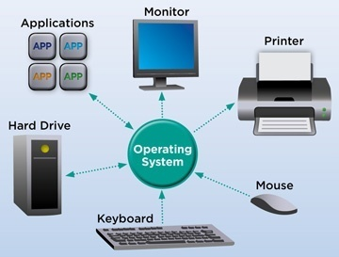
OS
OS stand for Operating System
Where,
“O” Stand for Operating :
Means:-
Control /Handling
What to control and How to control
“S” stand for System:
Means:-
Procedure
Mechanism
Rules
Interconnection
Which has some Rights

Slide 4
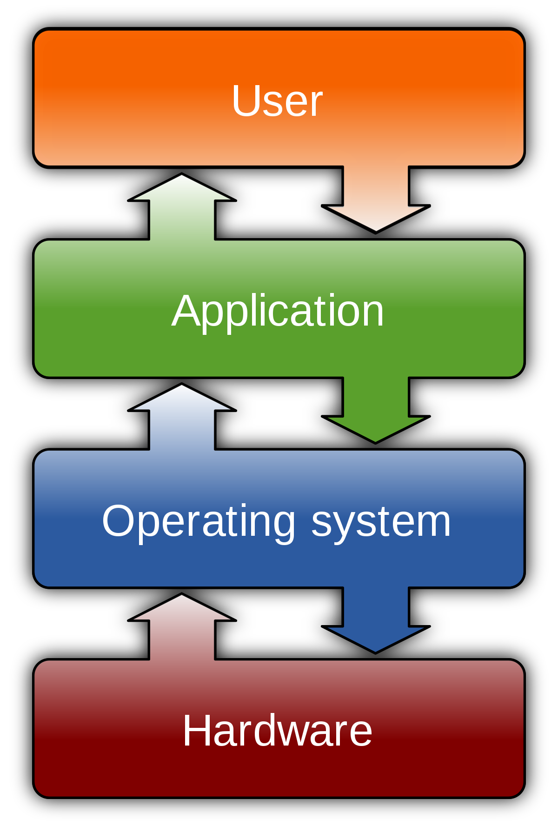

Definition
OS is “Set of programs”
OS is “System Software”
OS is “Intermediate” between user and hardware
OS is “Resource Manager”
OS is “Government Like Structure”
OS is “Resource Allocator”
OS is “Mother” to Small Kid’s
OS is service provider and “All in all”
Examples: DOS, XP, Millennium (ME), windows server, vista, Linux, MAC operating system, Sun OS, Android, IOS, Blackberry, Symbian and many more.

Slide 5
Thank You
We will meet Soon!!!!!!!!!!

